Slide 1
Predicting Drug Effects Using Text Analytics
Data hackathon 2016
Ganga|JYOTI|KARTHIK|MADHUsudhan|SAKSHI

Slide 2
Phases of Analysis
1.Crawling User info including reviews and ratings
Unstructured data to Structured
2. Web Interface
User Interface for data overview 3. Sentiment Analysis and Text Clustering Text Clustering to identify drug effects
Algorithm training with key words for Sentiment Analysis
Analyses of Clusters to identify effected age group Word cloud for visualizing nature of drug effects

Slide 3
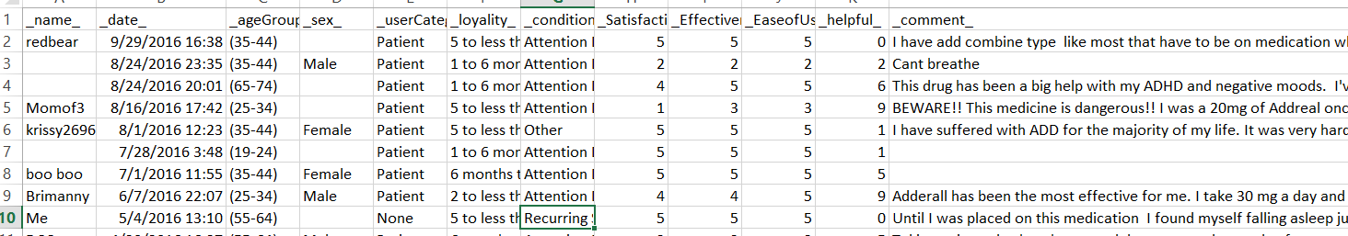
Web Crawling
Crawled data from WebMD for Adderall oral drug
Python, file types from JSON to CSV
Total Reviews: 1666

Slide 4
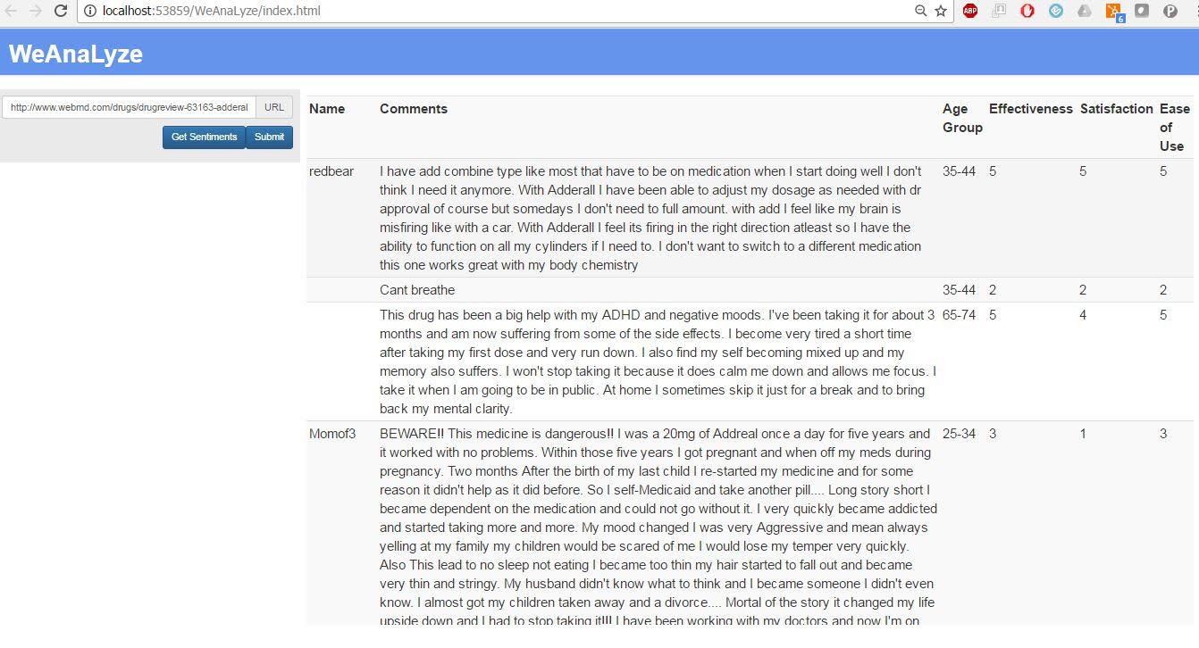
Web Interface: Python, Angular js, HTML

Slide 5
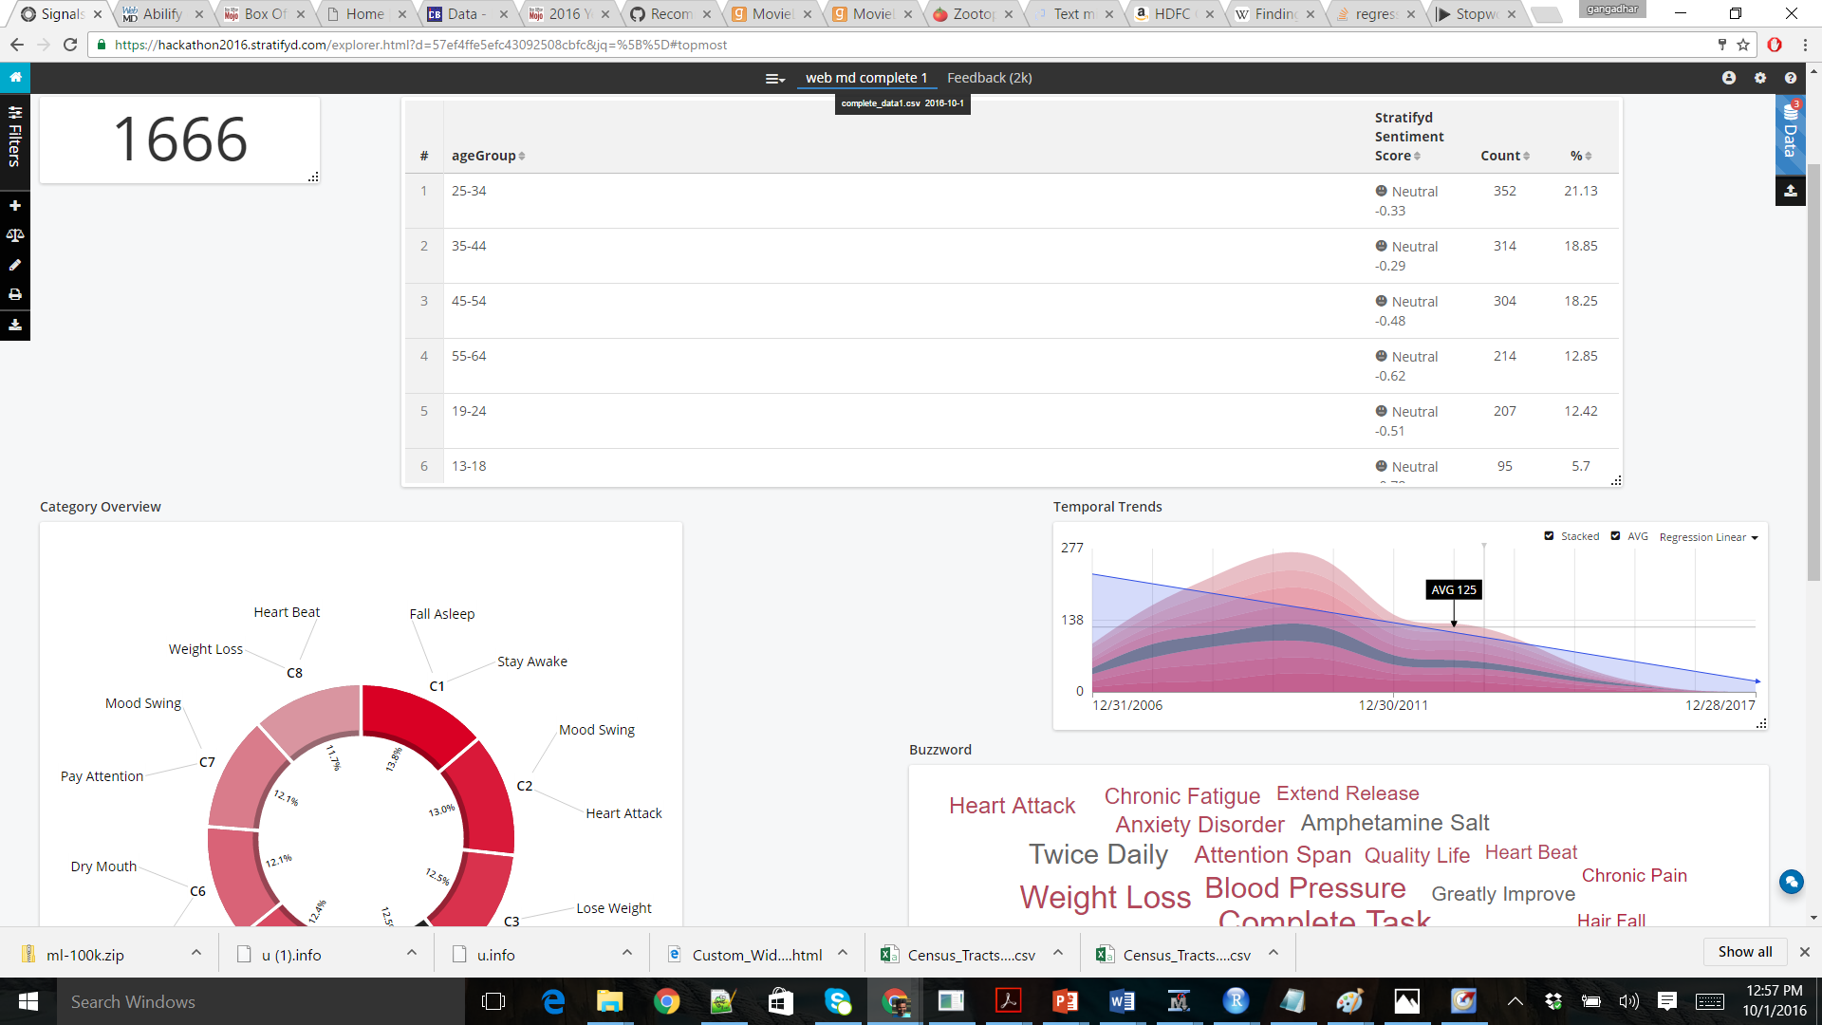
Signals Analysis: Used csv file to do sentiment analysis using Signals

Slide 6
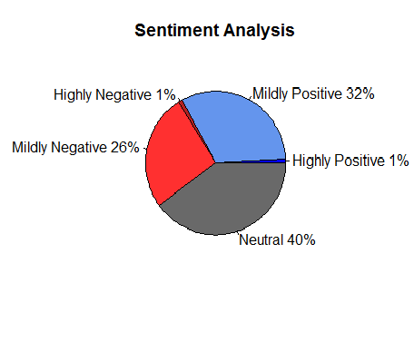
Sentiment Analysis- User Reviews Technology Used: R (classified words as positive and negative)

Slide 7
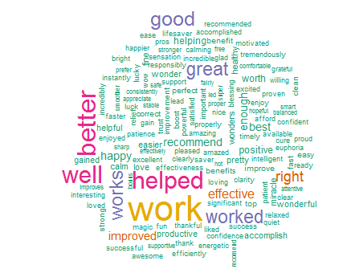
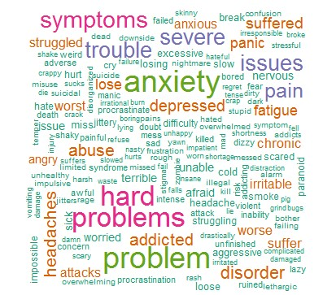
Word Cloud of Reviews: IN R
Positive Sentiment
Negative Sentiment

Slide 8
Text Clustering: Using SAS E Miner
Cluster Label | Frequency | % | RMS std
Children With Negative Drug Effects | 608 | 36% | 0.124
Overall Well being with few identified Effects | 745 | 45% | 0.128
SAS EGP, SAS Text Miner

Slide 9
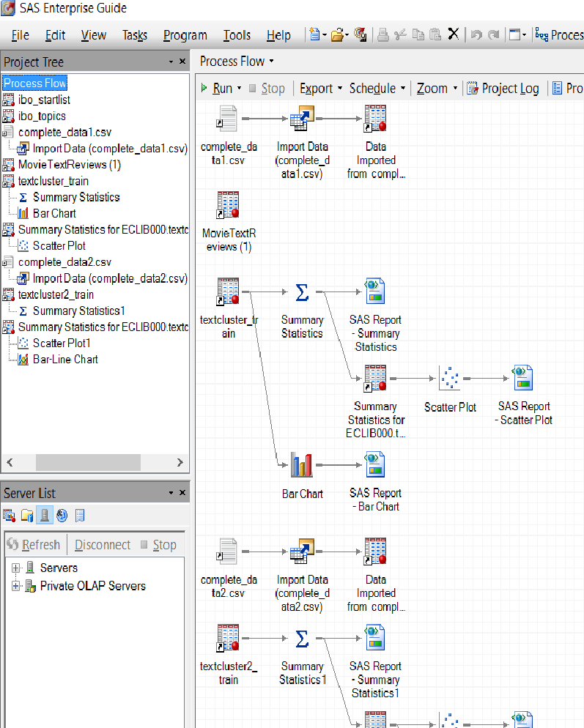
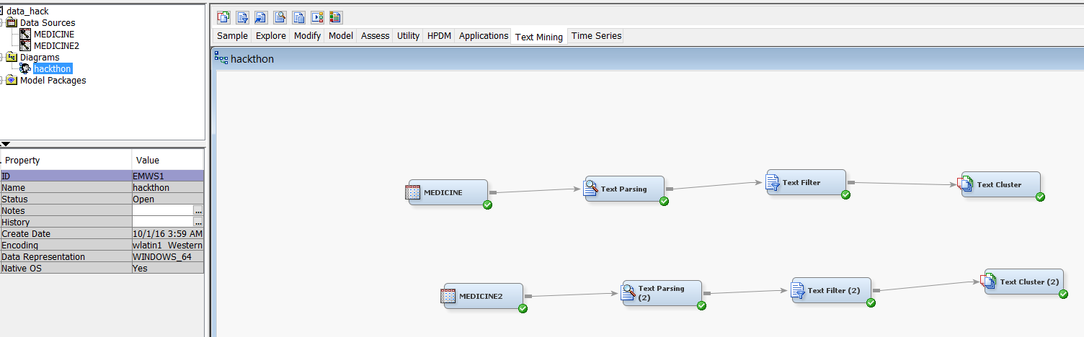
Cluster Analysis Process Flow
Formation of Clusters: Enterprise Miner
Analyzing Clusters: Enterprise Guide

Slide 10
Validating Drug effects Cluster 1: Age Vs Satisfaction

Slide 11
Validating Drug effects For cluster 2: Age v/s drug effects

Slide 12
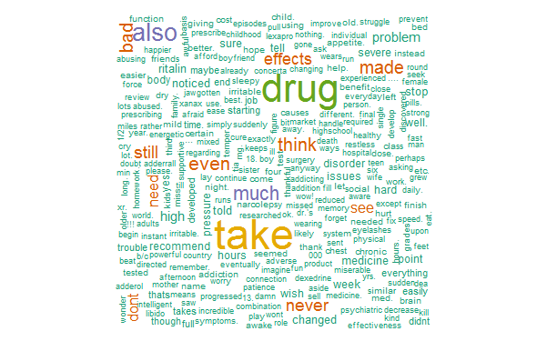
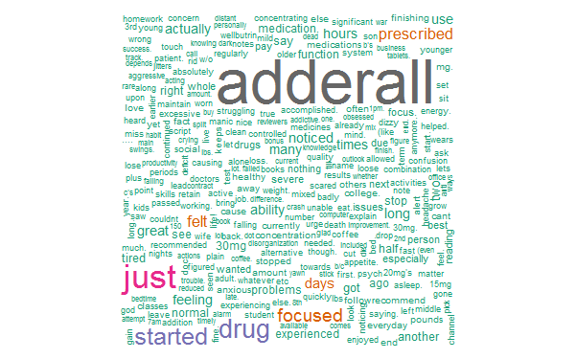
R Word Cloud
Cluster 1: Children
Cluster 2: Overall

Slide 13
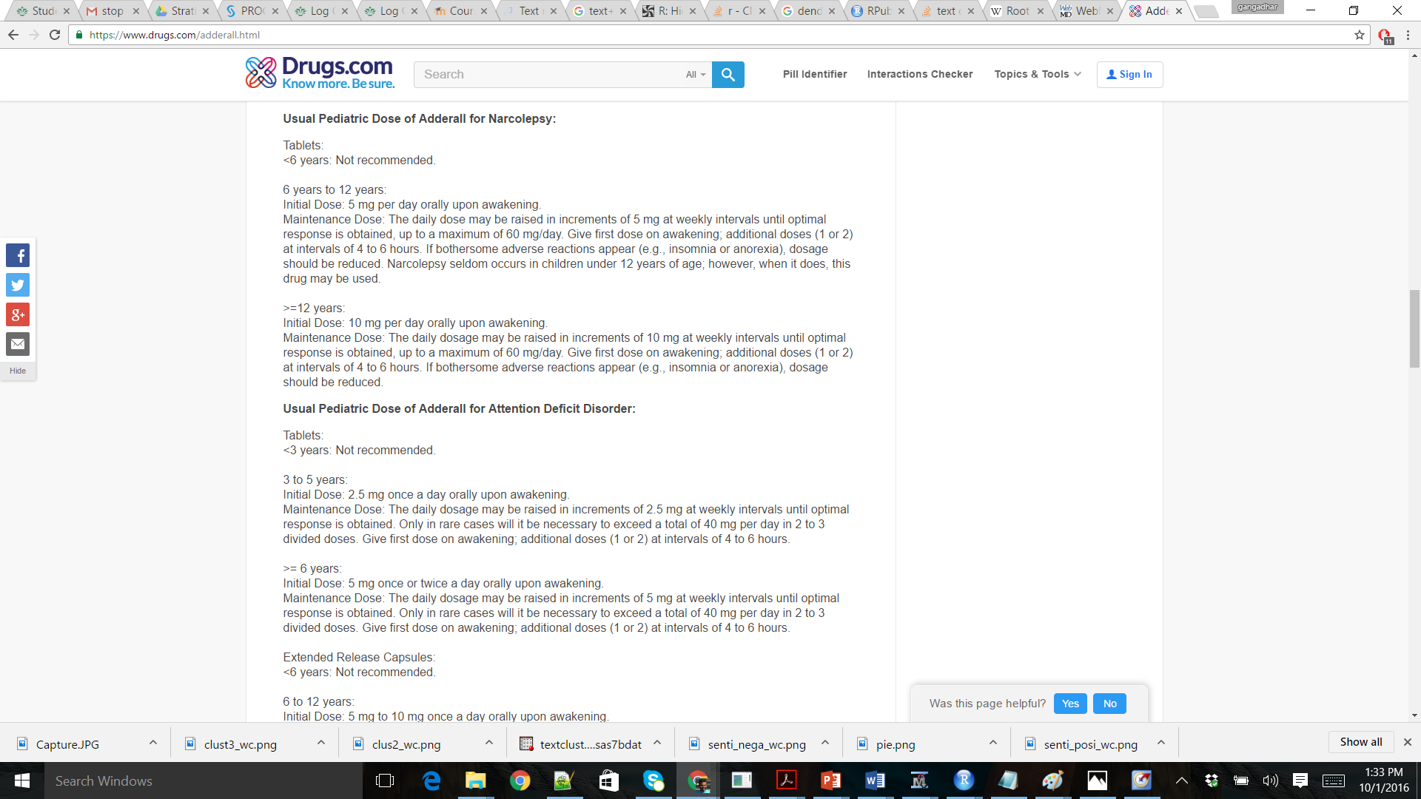
Cross Validation of Final Results https://www.drugs.com/adderall.html

Slide 14
Thank You

